Slide 1

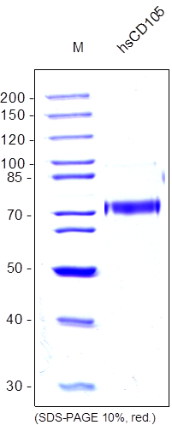
ReliaTech GmbH
Recombinant human soluble CD105
(Cat # S01-024 / S01-025)
Figure 1: SDS-PAGE analysis of recombinant human soluble CD105 produced in insect cells. Sample was loaded under reducing conditions in 10% SDS-polyacrylamide gel and stained with Coomassie blue.
http://www.reliatech.de / info@reliatech.de

